Slide 1
PROFIT ANALYSIS

Slide 2
Problem Understanding
Objective:
Analyze the relationship between startup investments and profit.
Identify the factors that have the greatest impact on profit.
Build a regression model to predict startup profit.

Slide 3
Dataset Description
Total Records : 50 Startups
R & D Spend
Administration Spend
Marketing Spend
State
Profit (Target Variable)

Slide 4
Data Cleaning
Checked for missing values
No missing values found
Verified numerical and categorical columns
Checked for duplicate records
Dataset ready for regression analysis

Slide 5
Regression Analysis
Multiple Linear Regression is used to predict a target variable (Profit) based on multiple input features. It finds the best-fit line by minimizing the error between predicted and actual values.

Slide 6
Model results
R² = 0.9507
Profit = 50122.19 + 0.8057(R&D) - 0.0268(Admin) + 0.0272(Marketing)
R&D is the strongest predictor of Profit.

Slide 7
predictions
Input 1 Predicted Profit = 70,037.90
Input 2 Predicted Profit = 70,554.57

Slide 8
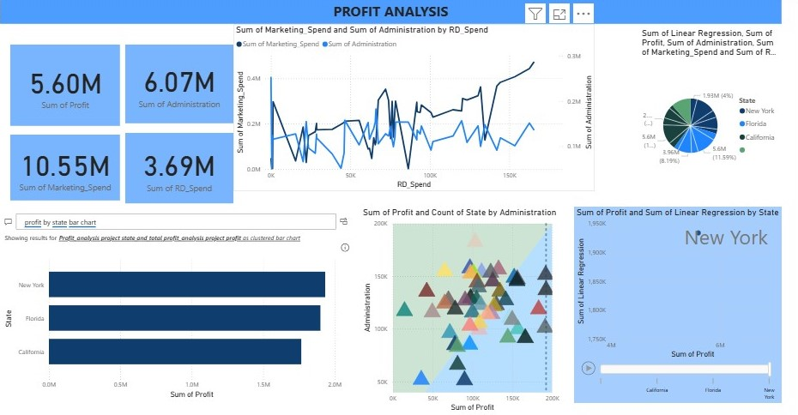
Visualizations power bi dashboard

Slide 9
Insights
R&D Spend has the highest positive correlation with profit.
Marketing spend positively influences profit.
Administration has minimal/negative impact.

Slide 10
recommendations
Increase investment in R&D.
Optimize Marketing ROI.
Monitor Administration expenses.

Slide 11
CONCLUSION
R&D is the primary driver of profitability. Marketing contributes positively, while Administration spending has limited impact.

